Slide 1
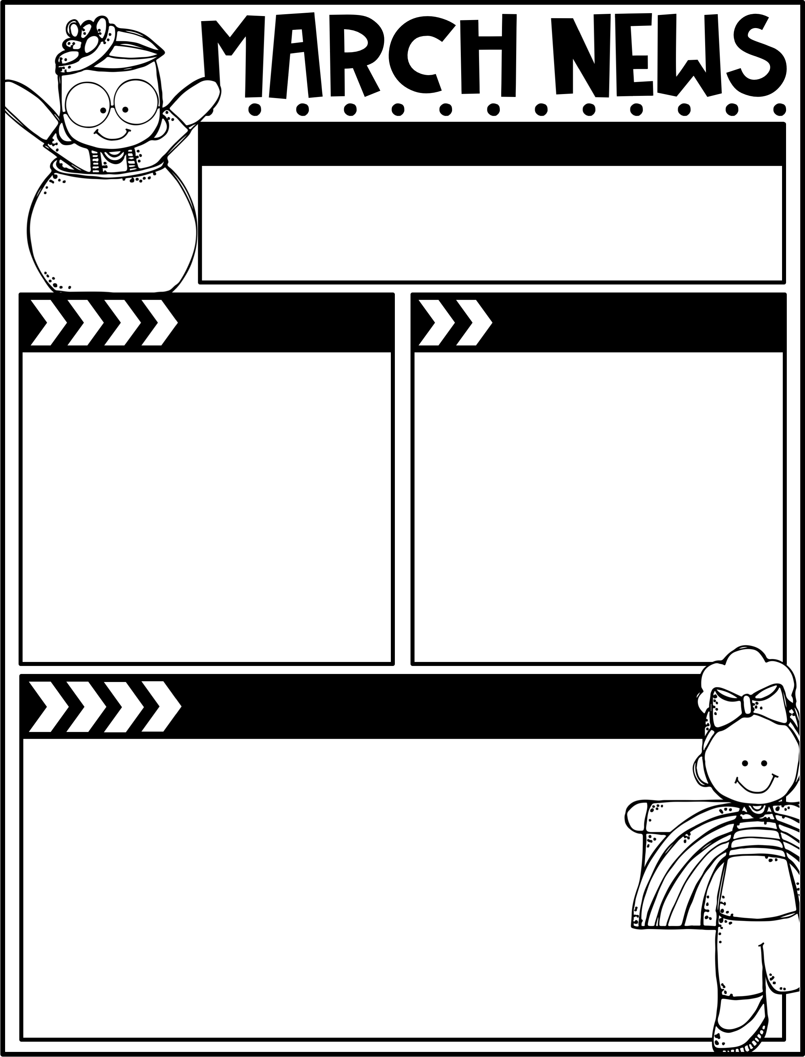
March 14, 2025
The Moreau Heights family is committed to providing a positive and safe learning environment to support responsible and productive citizens.
Phone:
573-659-3180
Plan Time:
1:35-2:25 pm
Emails:
mason.johnson@jcschools.us
danielle.mcgeorge@jcschools.us
theresa.schell@jcschools.us
Calendar
Learning Targets
M 03/17 C Day
Tu 03/18 A Day
W 03/19 B Day
Th 03/20 C Day
F 03/21 A Day, Library Check-Out
March 24-28 No School, Spring Break!
Reading/Writing
I can put a list of words in alphabetical order.
I can read a story featuring words ‘o’.
I can sort words with “o_e” > /oe/ and /u/.
I can spell words with the suffixes –tion, -el, and –le and the Tricky Word Schwa and will alphabetize words featuring these suffixes.
Math
I can use place value drawings to represent subtraction with up to 2 decompositions & relate them to written recordings.
I can use place value drawings to represent subtraction from numbers with 0 in the tens place.
I can subtract by using multiple strategies & defend an efficient strategy.
Social Studies
I can identify where goods come from.
Things to Know
Specials Schedule:
Library Check-Out:
Second grade has check-out on Fridays! Please help your child remember their books!
Please feel free to send in class
snacks!!!
Please continue reading
with your child at home!
 | Mr. J | Mrs. M | Ms. S
A | Music | PE | Art
B | PE | Art | Music
C | Art | Music | PE

